Slide 1
Prediction of client deposit term on Bank Marketing Data
Statistical Data Analysis Project
Mod.B
Data 30-04-2020
CHRISTIAN RICCIO P37000002
GIACOMO MATRONE P37000011

Slide 2
OUTLINE OF THE WORK
Statistical Question
Data overview
Exploratory Analysis
Data Pre-processing
Algorythms overview:
Results
XGBoost
Results discussion and Conclusions

Slide 3
STATISTICAL QUESTION
Is it possible for a Bank to know if a client will subscribe a term deposit during a marketing campaign?
The answer should be found among:
Deep Analysis of the involved variables:
Undestand the variables
Analize their corrrelations
Selection of a model and its validation

Slide 4
OVERVIEW OF THE DATA
Categorical Variables
Job
Marital
Education
Default
Housing
Loan
Contact
Month
Day of the week
Poutcome
Y (the target)
Numeric Variables
Age
Duration
Campaign
Pdays
Previous
Emp.var.rate
Cons.price.idx
Cons.conf.idx
Euribor3m
Nr.emplyed
41188 Observations
21 Variables
10 numeric
11 categorical

Slide 5
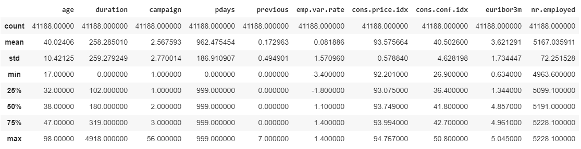
PRINCIPAL STATISTICAL INDEXES
Fig.1. Numeric description of the principal statistical indexes

Slide 6
STARTING POINT
The response variable y is dicotomic and holds the following values:
Y = yes 11% of counts
Y = no 89% of counts
We need to deal with imbalanced classes.
The following are some techniques we have used:
Choosing the right metrics (F1-score, …)
Oversampling techniques (SMOTE)
Stratifying train and test split

Slide 7
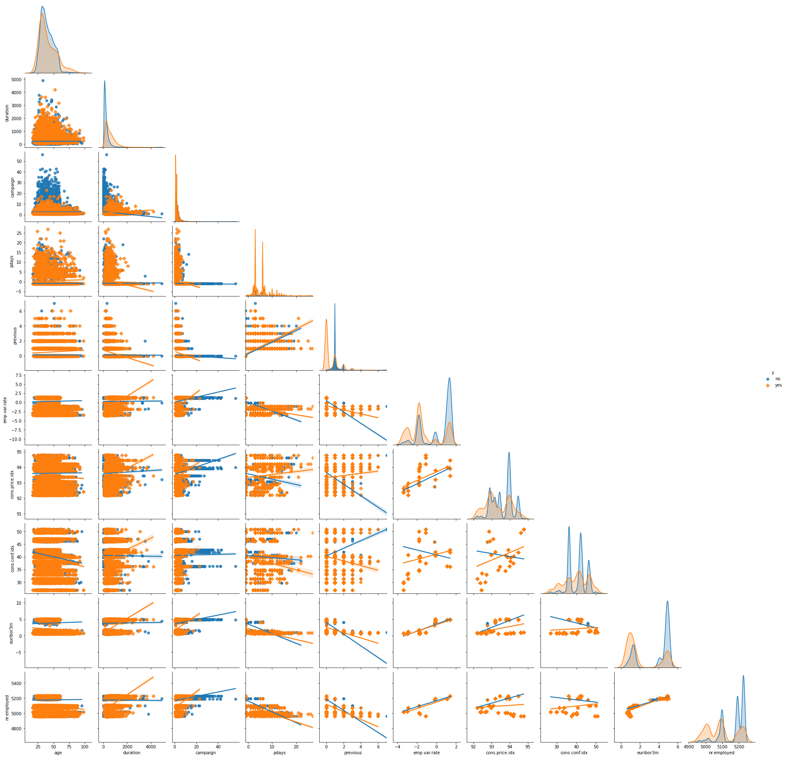
EXPLORYING THE VARIABLES
NO
YES
Fig.2. Pairplot of the numeric variables

Slide 8
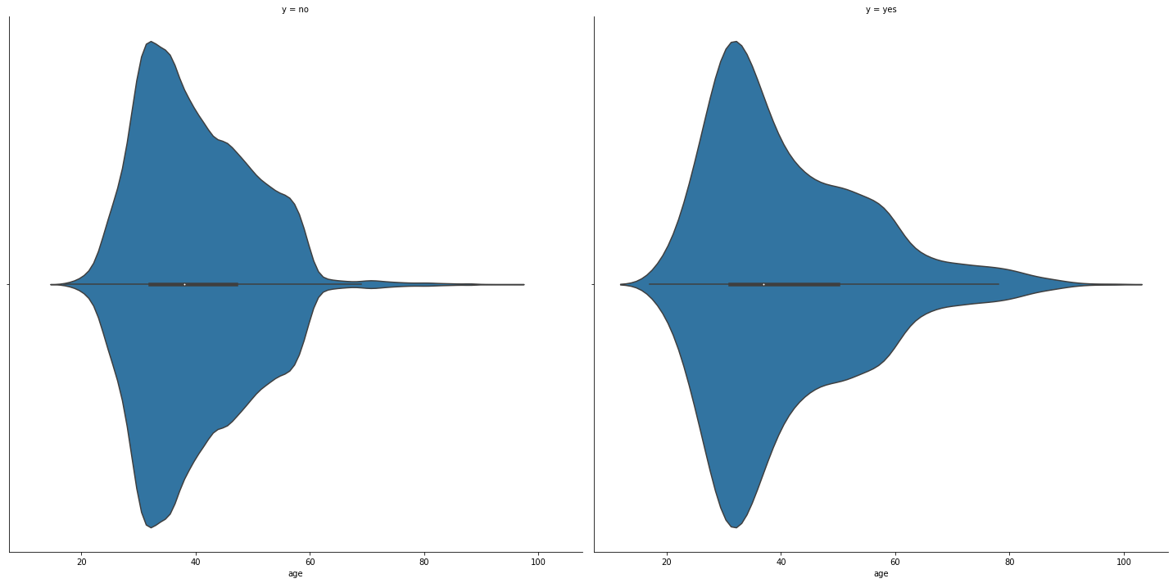
EXPLORYING THE VARIABLES
y = no
y = yes
Median
Interquartile range
Variables’ density function
Fig.3. Violin plots for the age varibale

Slide 9
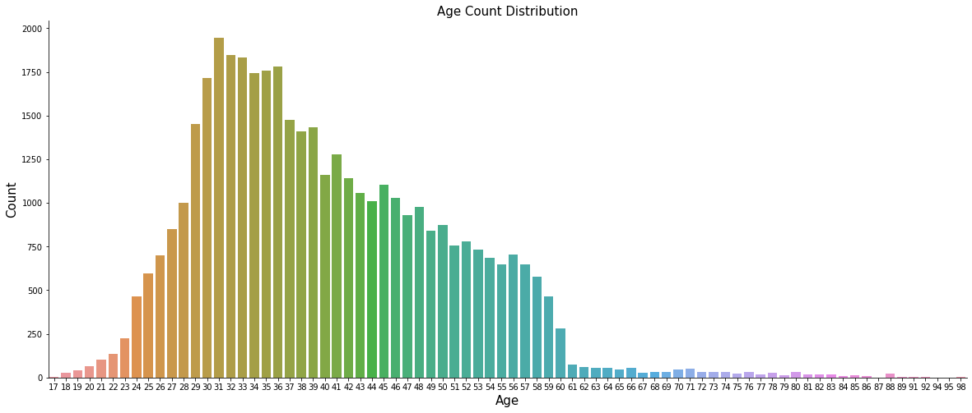
STILL WITH AGE
Wide spread of ages
Age is unimodal
Max
Fig.4. Count distribution for the age variable

Slide 10
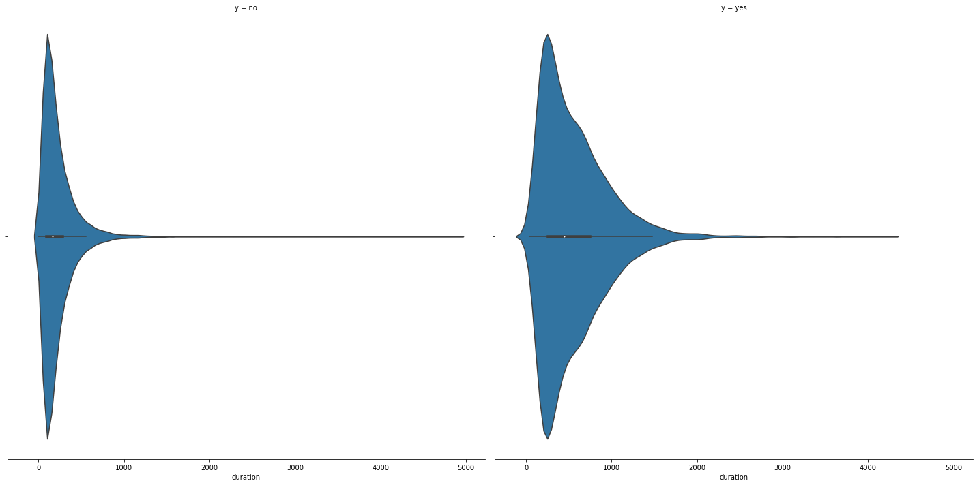
DURATION OF THE PHONE CALL
y = no
y = yes
Log-normal
Short duration
Fig.5. Violin plots for the duration varibale

Slide 11
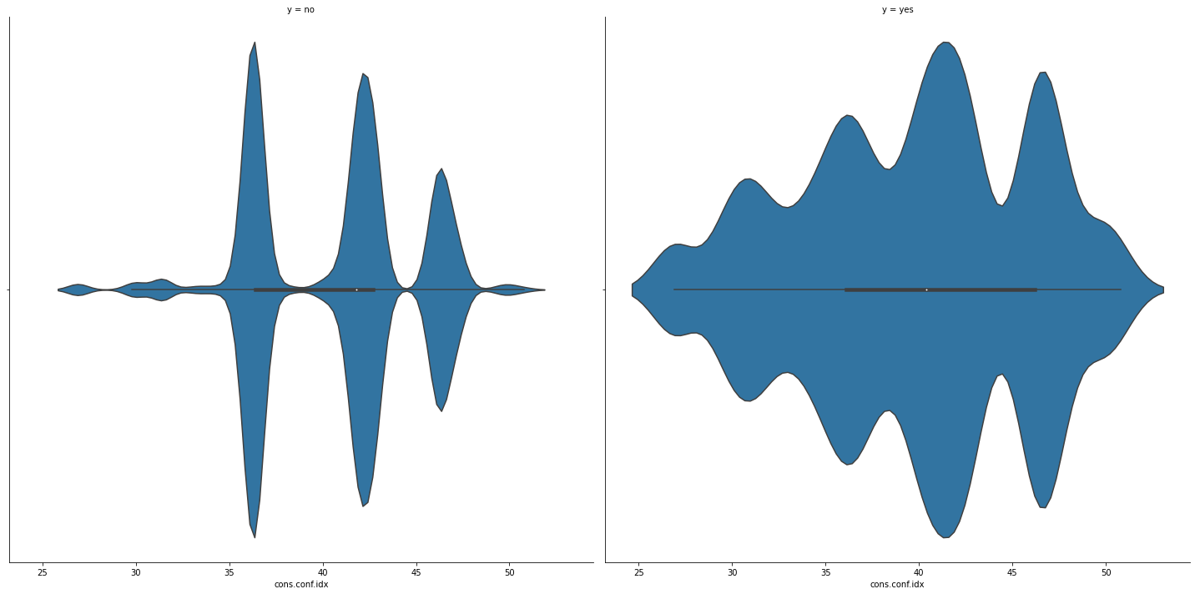
INSIGHTS ON MULTIMODAL VARIABLES
y = no
y = yes
Multimodal behaviour
Consumers more equally distributed
Weak predictor
Fig.6. Violin plots for the consumer confident index variable

Slide 12
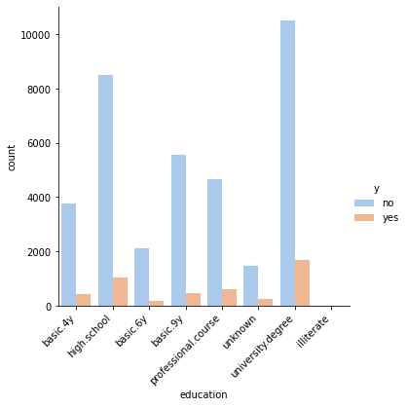
Does education affect the choice of opening a deposit term?
Lot of people tends to not open the deposit term
Response variable and education seems to be attracted
Fig.7. Counts for the education variable

Slide 13
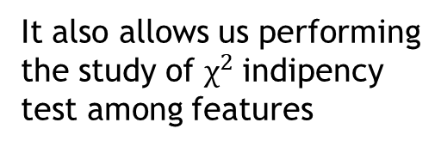
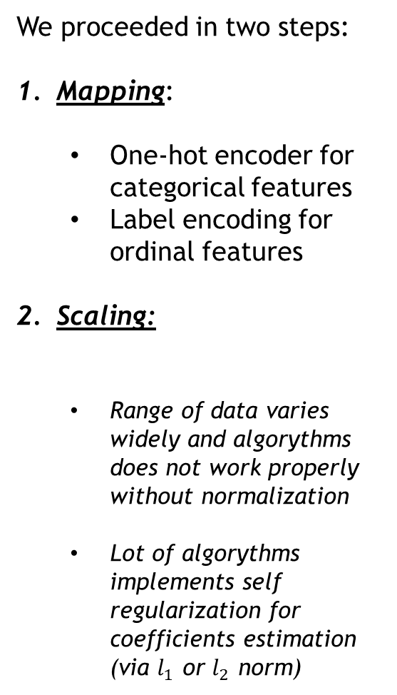
DATA PRE-PROCESSING
We proceeded in two steps:
Mapping:
One-hot encoder for categorical features
Label encoding for ordinal features
Scaling:
Range of data varies widely and algorythms does not work properly without normalization
Lot of algorythms implements self regularization for coefficients estimation (via $l_{1}$ or $l_{2}$ norm)
It also allows us performing the study of $χ^{2}$indipency test among features
For the response variable the one-hot encoder works as follow:
1 for the y = yes
0 for the y = no
We performed min-max rescaling and normalization
Coefficients estimates change substantially when multiplied for a different scaled feature
Some classifiers (i.e. ones we used) calculate the Euclidean distance beetwen points

Slide 14
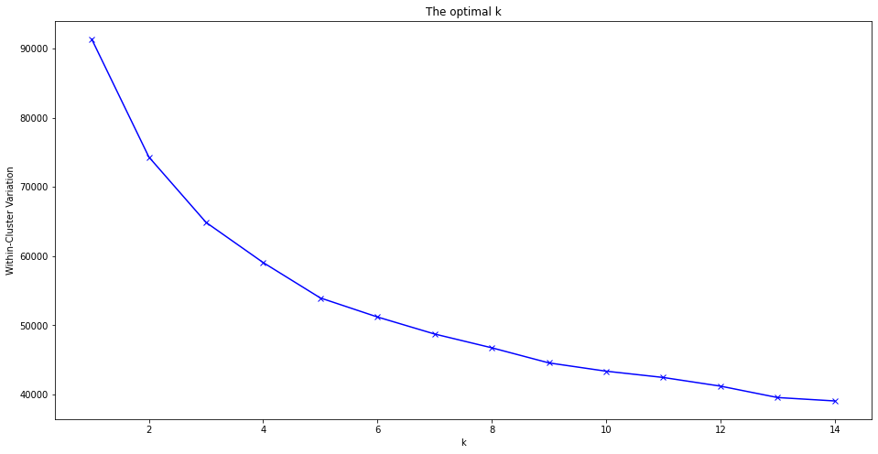

DISCOVER PATTERNS INTO DATA: Cluster Analysis
Here scaling comes helpful.
We clusterize data via:
K-means
is all about to minimize:
Hierarcical clustering
“In order to be an immaculate member of a flock of sheep,
one must, above all, be a sheep oneself.” —Albert Einstein
Fig.8. ‘Elbow method’ for set the optimal number of clusters in K-Means
The choiche for the exactly number of K-clusters is K=5
We would like to emphasize the importance of cluster analysis, in discovering hidden patterns into the data.

Slide 15
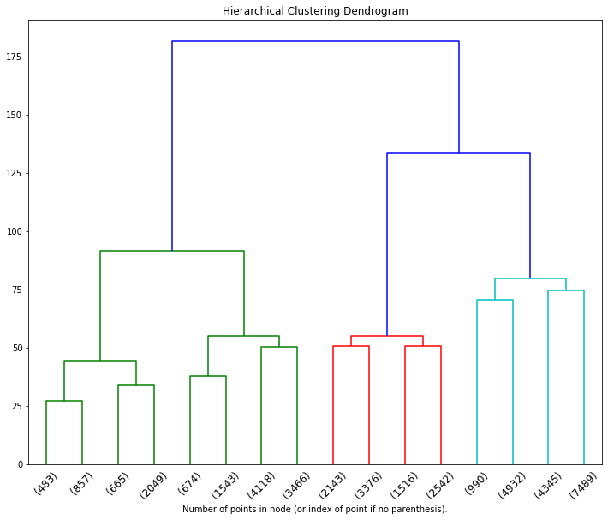
The main cluster
Fisrt aggregations made shows the shortest branch
The labels represent the indexes of the data points
branches
nodes
We can identify 3 groups (green, red and blue)
Attention:
The distance between data points is the Eucledian one
The criterion for aggregate, by default is the WARD
Fig.9. Dendrogram resulting from the hierarchical clustering
roots

Slide 16
CLASSIFICATION SET APPROACH
Recall that we were dealing with inbalanced classes of the target
With the purpose of comparing medoles, we propose:
Logistic Regression:
Regularization
Rensampling Cross Validation
Results
Decision Tree:
Rensampling Cross Validation
Results
K-Nearest Neighbors:
Results
In the train/test split phases, for each of the 3 algorythms proposed we have used the stratification of the y response because of its imbalanced nature, in order to get same proportions

Slide 17

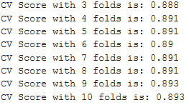
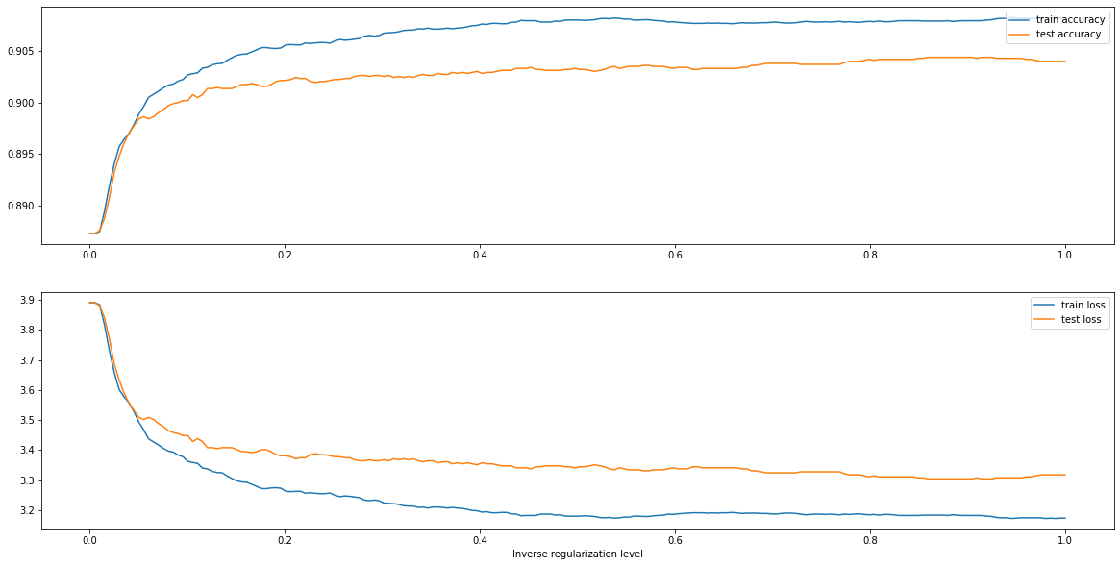
1. LOGISTIC REGRESSION
CV scores:
Minimaze the loss function
Fig.10. In the bottom chart: loss function for train and test sets.
In the upper chart: train and test accuracy

Slide 18
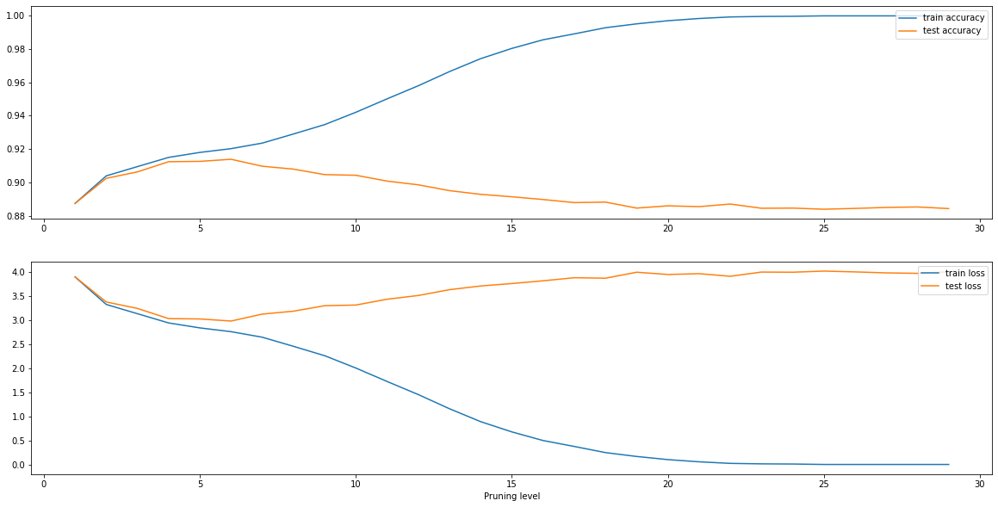
2. DECISION TREE
This result refers to the estimation of the model after pruning
Fig.11. In the bottom chart: loss function for train and test sets.
In the upper chart: train and test accuracy

Slide 19
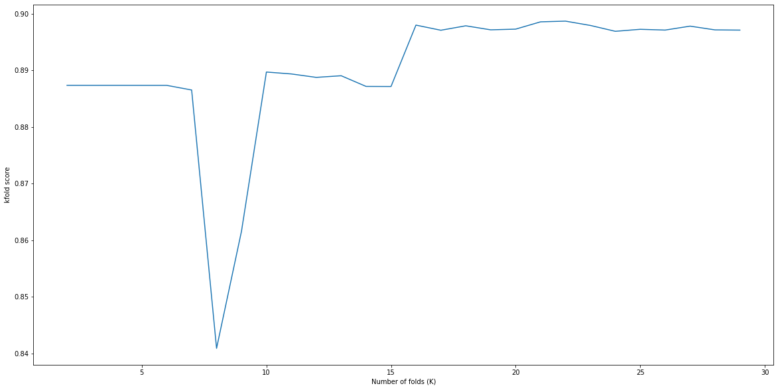
2. DECISION TREE
Fig.12.Accarucy score vs number of folds performing k-folds CV

Slide 20
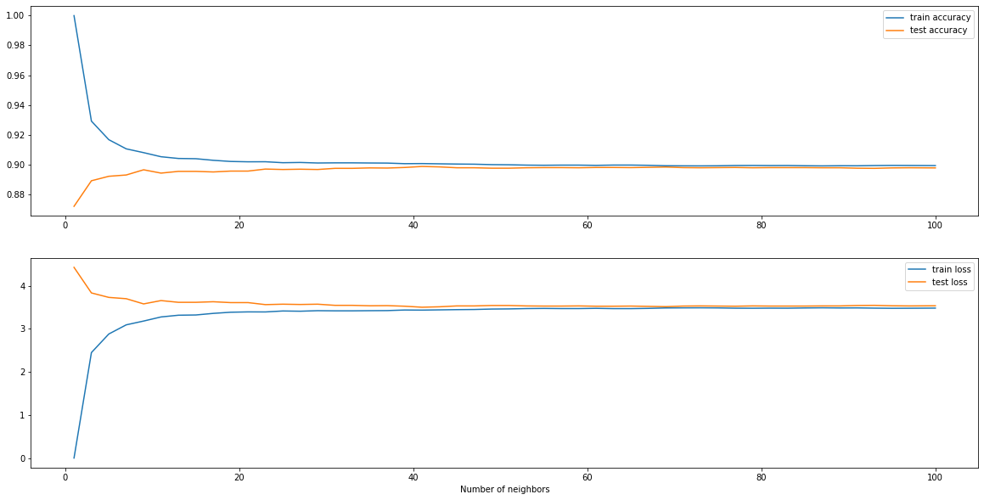
3. K-NEAREST NEIGHBORS
Fig.12. In the bottom chart: loss function for train and test sets.
In the upper chart: train and test accuracy

Slide 21
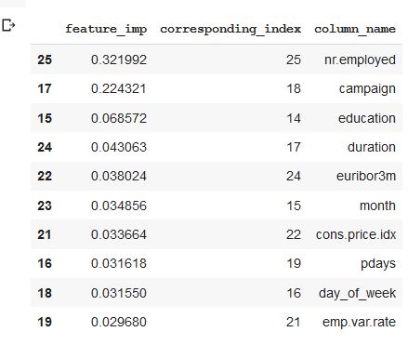
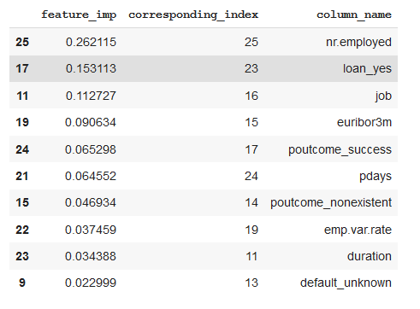
MODEL SELECTION AND ITS VALIDATION
Here is listed the features importance from XGBoost
AFTER SMOTE
BEFORE SMOTE
Fig.13. Top 10 feature importances, resulting from XGBoost before applying SMOTE
Fig.14. Top 10 feature importances, resulting from XGBoost after applying SMOTE

Slide 22
CONCLUSIONS
In a marketing campaign it is important to understand and control parameters that might make the difference.
Obtaining informations on the role of the variables is a key role in collecting results for a bank. That’s why we chose XGBoost in order to set the feature importances

Slide 23

THANK YOU FOR YOUR ATTENTION

